Slide 1
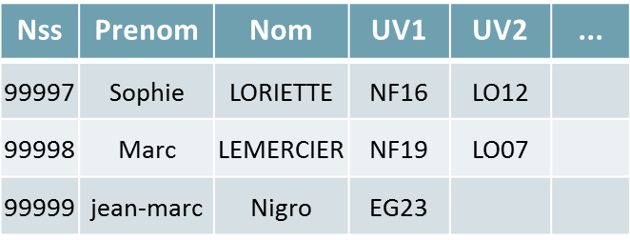
Nss | Prenom | Nom | UV1 | UV2 | ...
99997 | Sophie | LORIETTE | NF16 | LO12
99998 | Marc | LEMERCIER | NF19 | LO07
99999 | jean-marc | Nigro | EG23

Slide 2


Slide 3
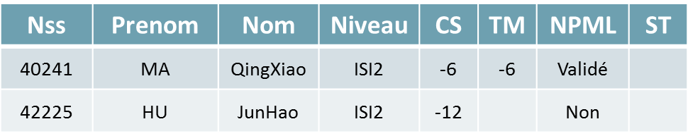
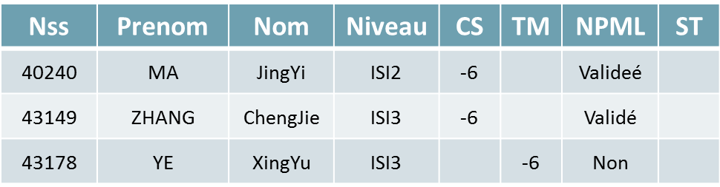
Nss | prenom | nom | Niveau | CS | TM | EC | ME | CT | NPML | ST
40240 | MA | JingYi | ISI2 | 6 | 0 | 0 | 0 | 0 | 0 | 0
43149 | ZHANG | ChengJie | ISI3 | 6 | 0 | 4 | 0 | 0 | 0 | 0
43178 | YE | XingYu | ISI3 | 0 | 6 | 0 | 8 | 8 | 1 | 0
Nss | Prenom | Nom | Niveau | CS | TM | NPML | ST
40241 | MA | QingXiao | ISI2 | -6 | -6 | Validé
42225 | HU | JunHao | ISI2 | -12 |  | Non

Slide 4
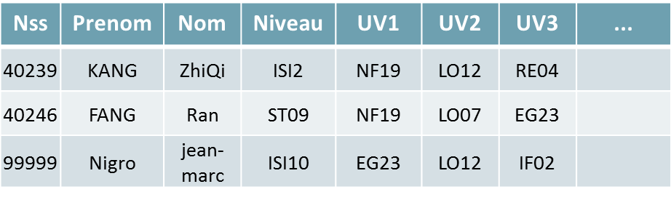
Nss | prenom | nom | Niveau | UV1 | Note1 | UV2 | Note2 | UV3 | Note3
40239 | KANG | ZhiQi | ISI2 | NF19 | A | LO12 | B | RE04 | A
40246 | FANG | Ran | ST09 | NF19 | B | LO07 | A | EG23 | B
99999 | Nigro | jean-marc | ISI10 | EG23 | A | LO12 | A | IF02 | A
Nss | Prenom | Nom | Niveau | UV1 | UV2 | UV3 | ...
40239 | KANG | ZhiQi | ISI2 | NF19 | LO12 | RE04
40246 | FANG | Ran | ST09 | NF19 | LO07 | EG23
99999 | Nigro | jean-marc | ISI10 | EG23 | LO12 | IF02

Slide 5


